Slide 1
Evolving Dataset Storage Using a General Purpose Schema
computer science 380 Final Project
Spring 2013
Professor Kapfhammer
By: Braden Licastro

Slide 2
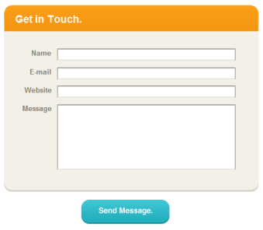
Current Methods
Web forms implement three types of data storage
XML based
Spreadsheet based
Parameter passed submission

Slide 3
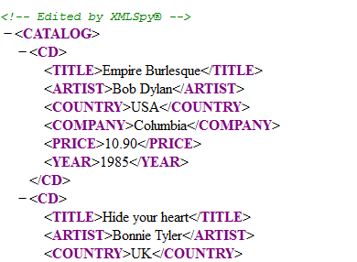
XML Based Web Forms
Data submitted by the form is stored directly in an XML file
Cannot easily set access privileges, therefore insecure in most cases
Redundancy creates excessively large file sizes

Slide 4
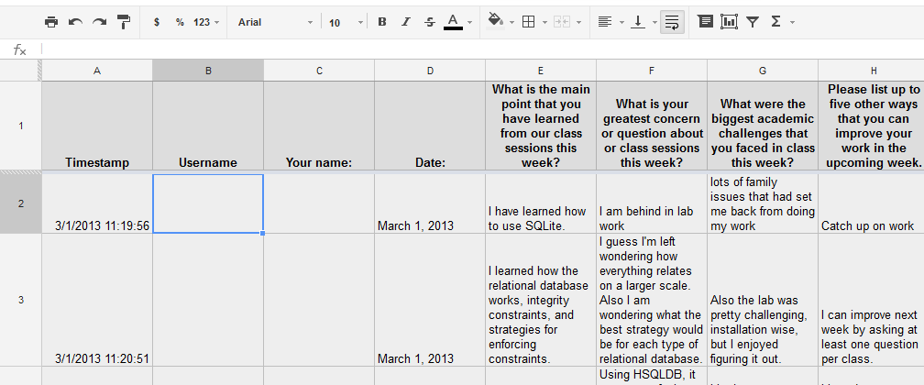
Spreadsheet Based Web Forms
Data submitted by the form is stored directly in an online spreadsheet or CSV file
Cannot easily set access privileges, therefore insecure in most cases
Cannot change schema after data submissions begin

Slide 5
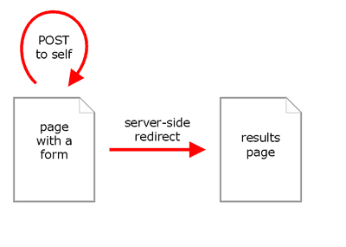
Parameter Based Web Forms
Data kept in spreadsheet POST data
As large amounts of data are collected, load and submit times increase as data is appended
Cannot change form without resetting collected data

Slide 6
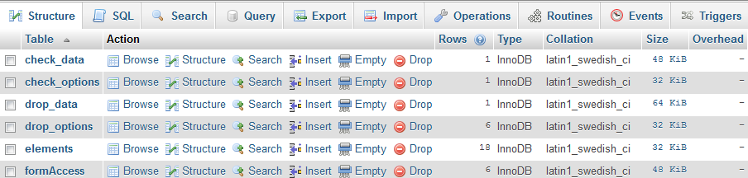
Proposed Solution
Database driven form
Allows for form changes without resetting collected data
Reduces redundancy requiring lower storage costs
Queries performed server-side; user experience unchanged
Generic schema can be used for any form
Table-per-form database organization not needed

Slide 7
Implementation
Three randomly generated forms used to supply data
Two tables per input type
One for data
Second for element configuration
Data submission linked back to submitter

Slide 8
Conclusion
Successfully implemented relational schema
Accepted and successfully stored all three forms’ data
Minimal storage overhead.
Uses 20% of the space that Google forms uses for the same data in required three spreadsheets
Precise control over user access of data

Slide 9
Future Work
Implement user registration
Implement GUI form generator
Introduce data visualization for each form element
Allow for multiple viewing options per element

Slide 10
Thank you!
Questions? Comments?

